Slide 1
Setting up an ibutton
Start viewer
Determine mission parameters
Set the clock.
Set the time alarm.
Set the sample rate.
Set the temperature/humidity alarm.
Set the mission start delay.
Check when mission will end; select data rollover or not.

Slide 2
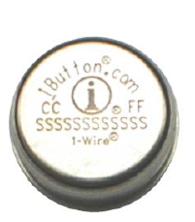
ibutton diagram
i/o or “lid”

Slide 3
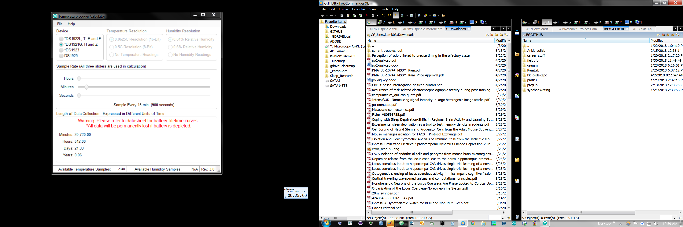
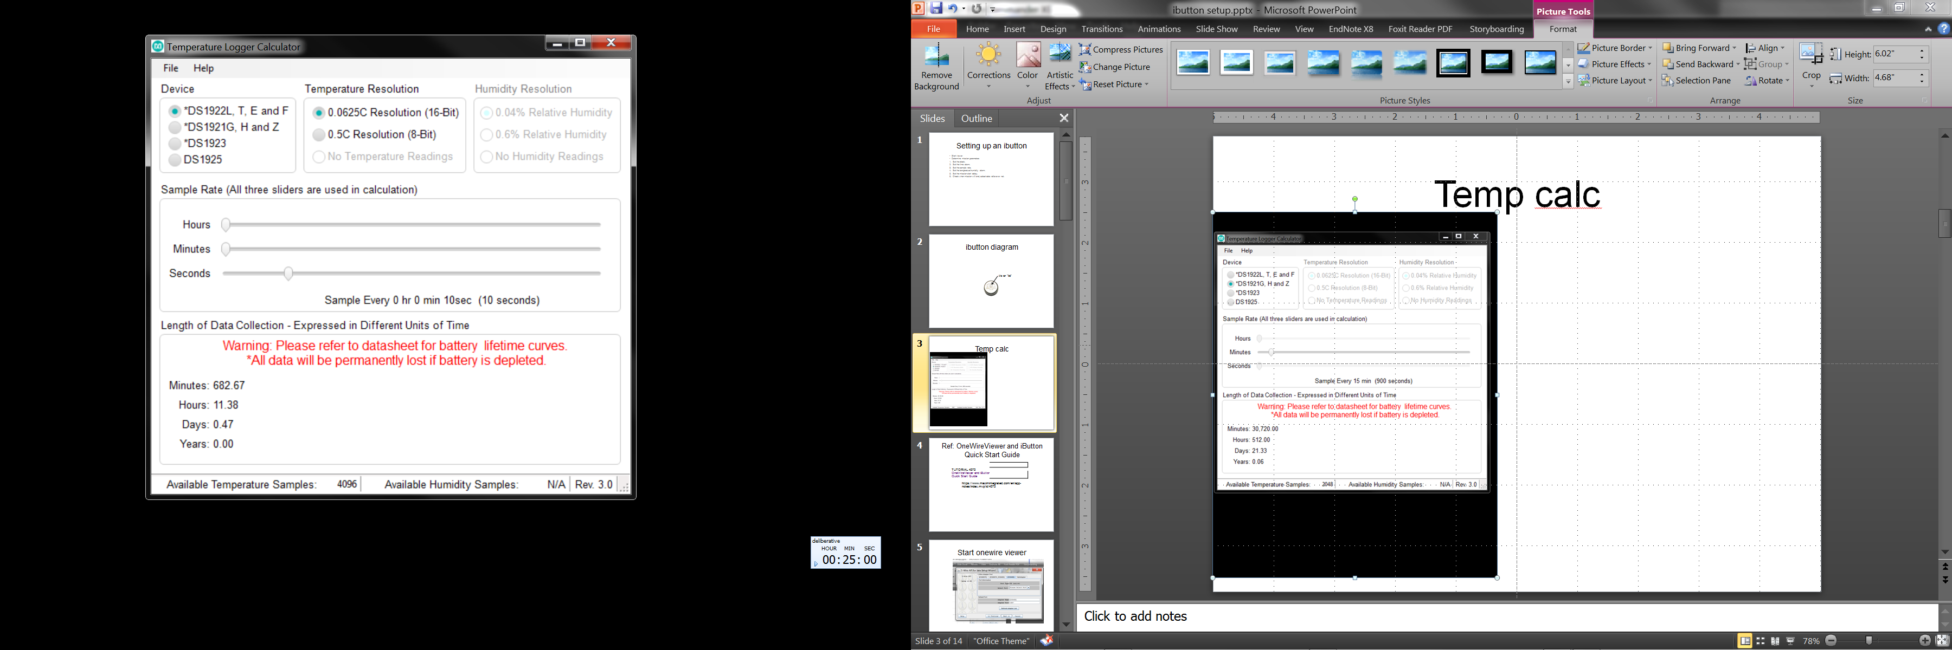
Temp calc
DS1921H
DS1922X

Slide 4
Ref: OneWireViewer and iButton Quick Start Guide
TUTORIAL 4373
OneWireViewer and iButton Quick Start Guide
https://www.maximintegrated.com/en/app-notes/index.mvp/id/4373

Slide 5
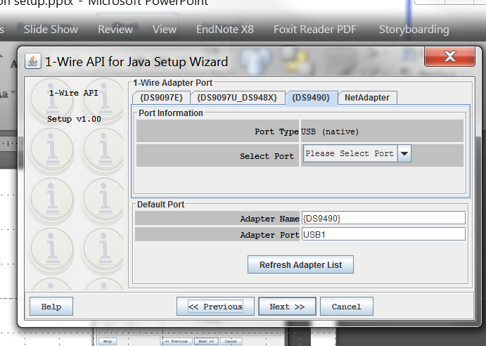
Start onewire viewer

Slide 6
Ref: OneWireViewer Tips and Tricks
APPLICATION NOTE 5057
OneWireViewer Tips and Tricks
https://www.maximintegrated.com/en/app-notes/index.mvp/id/5057

Slide 7
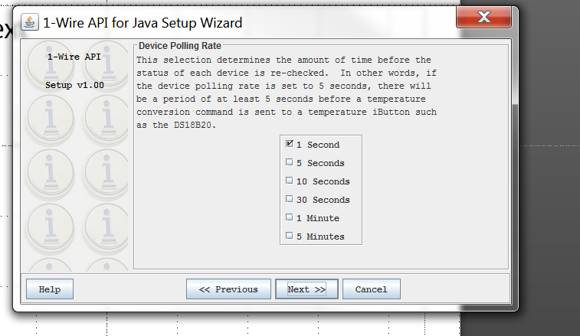
Polling rate
https://www.maximintegrated.com/en/app-notes/index.mvp/id/5057

Slide 8
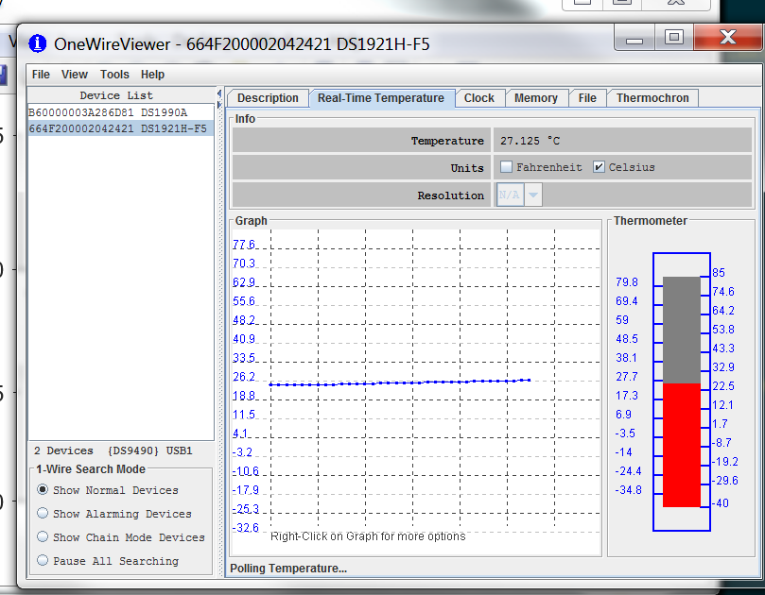
Check real-time temp

Slide 9
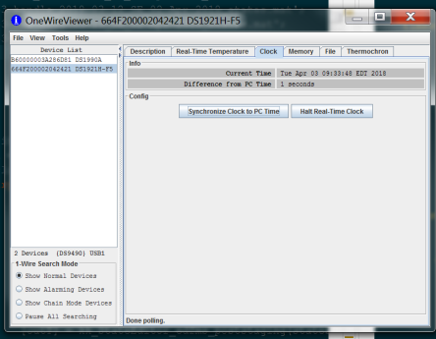
Synch clock to comp

Slide 10
Ref: Determining the Mission Parameters for Temperature Logger iButton® Devices
Determining the Mission Parameters for Temperature Logger iButton® Devices
https://www.maximintegrated.com/en/app-notes/index.mvp/id/5335
APPLICATION NOTE 5335

Slide 11
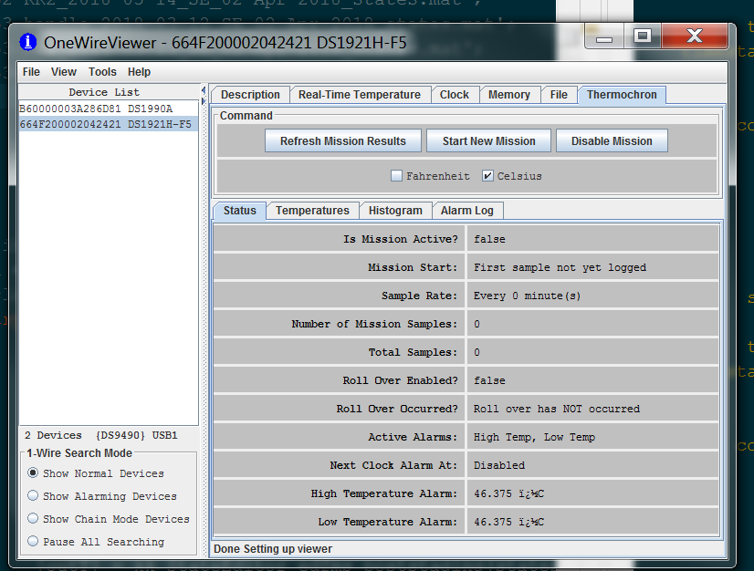
Thermochron tab

Slide 12
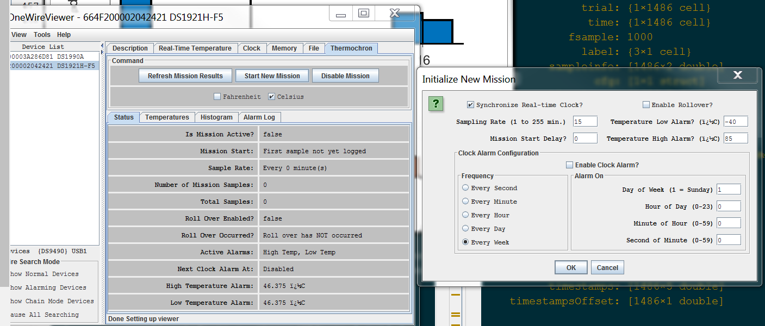
Select mission parameters

Slide 13
Extracting data
APPLICATION NOTE 3809
Exporting DS192x Logger Data from the OneWireViewer into Excel
Ref: https://www.maximintegrated.com/en/app-notes/index.mvp/id/3809

Slide 14
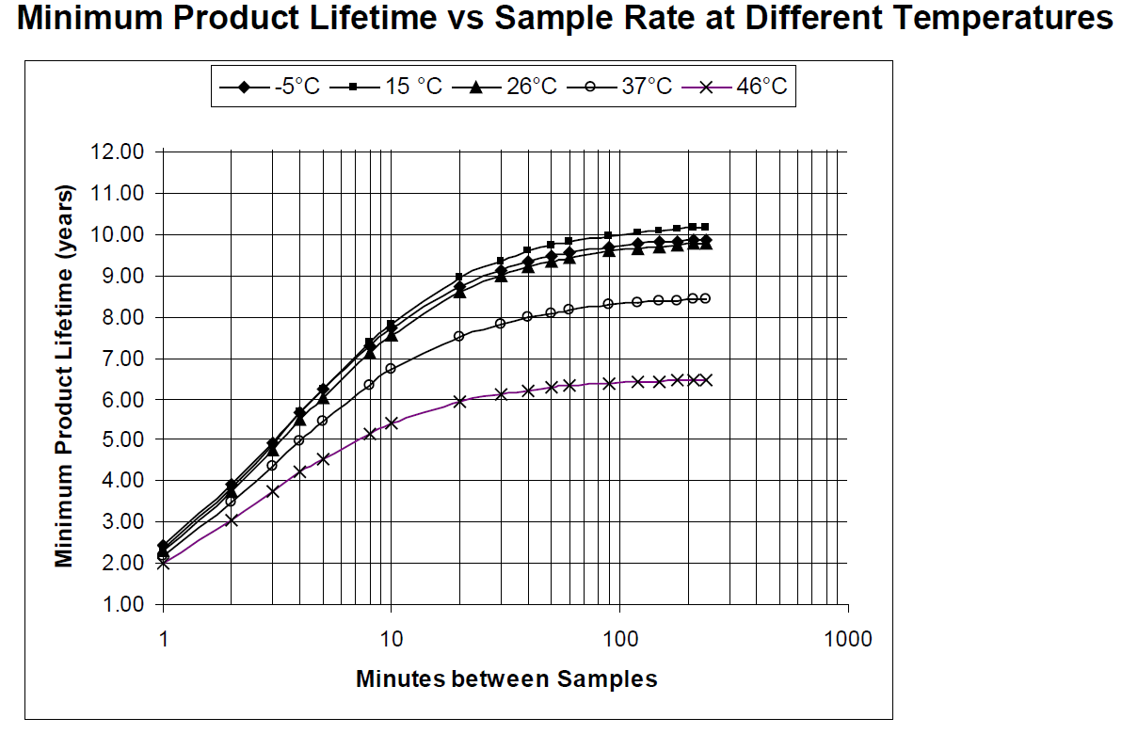
Lifetime of each iButton

